Slide 1
States
Are governing institutions that claim sovereignty within a specific territory. Their claim to rule their population is exclusive, and domestically they are defined by a monopoly on the legitimate use of violence.

Slide 2
Nations
Nations are groups of people who identify themselves that way (as a people) and on that basis claim a right to self governance. They are often, but not always, identified by a cultural trait such as language, religion, race or ethnicity.

Slide 3
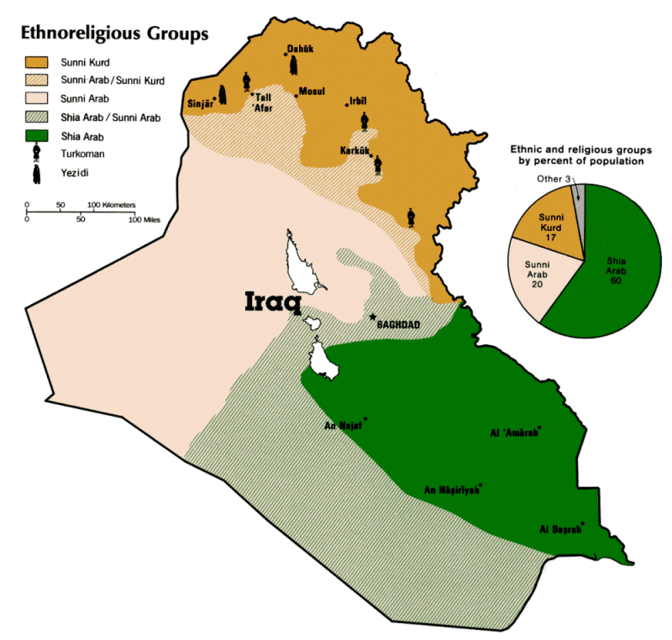
State and Nation in Iraq

Slide 4
Jus soli: “Territorial/political community”
Nation is determined by who the citizens are (Quote from French Revolution:
Second generation immigrants automatically get citizenship, so long as they are born on soil.
Belief in assimilation.
Supports naturalization for resident immigrants (In France, residents are 4 times as likely to get citizenship as they are in Germany, in the United States they are 10 times as likely, in Canada they are 20 times as likely)
Nationhood/ citizenship are seen as primarily political commitment centers on the state.

Slide 5
Jus sanguinis: “Community of descent”
Citizenship is determined by who is in the nation.
Children of members of the nation get citizenship regardless of where they are born.
(Comparison of Turkish immigrants to the German diaspora
in eastern Europe, Soviet Union).
Skeptical of assimilation.
Naturalization is very unusual .
Nationhood/citizenship is primarily ethno-cultural.
NOTE: Describe what constitutes “ethno-cultural”.

Slide 6
We the People of the United States, in Order to form a more perfect Union,
establish Justice, insure domestic Tranquility, provide for the common defence,
promote the general Welfare, and secure the Blessings of Liberty to ourselves and
our Posterity, do ordain and establish this Constitution for the United States of America.

Slide 7
THE PREAMBLE
In the name of God, the most merciful, the most compassionate
We have honored the sons of Adam.
We are the people of the land between two rivers, the homeland of the apostles and prophets, abode of the virtuous imams, pioneers of civilization, crafters of writing and cradle of numeration. Upon our land the first law made by man was passed, the most ancient just pact for homelands policy was inscribed, and upon our soil, companions of the Prophet and saints prayed, philosophers and scientists theorized and writers and poets excelled.

Slide 8
Acknowledging God's right over us, and in fulfillment of the call of our homeland and citizens, and in response to the call of our religious and national leaderships and the determination of our great (religious) authorities and of our leaders and reformers, and in the midst of an international support from our friends and those who love us, marched for the first time in our history toward the ballot boxes by the millions, men and women, young and old, on the thirtieth of January two thousand and five, invoking the pains of sectarian oppression sufferings inflicted by the autocratic clique and inspired by the tragedies of Iraq's martyrs, Shiite and Sunni, Arabs and Kurds and Turkmen and from all the other components of the people and recollecting the darkness of the ravage of the holy cities and the South in the Sha'abaniyya uprising and burnt by the flames of grief of the mass graves, the marshes, Al-Dujail and others and articulating the sufferings of racial oppression in the massacres of Halabcha, Barzan, Anfal and the Fayli Kurds and inspired by the ordeals of the Turkmen in Basheer and as is the case in the remaining areas of Iraq where the people of the west suffered from the assassinations of their leaders, symbols and elderly and from the displacement of their skilled individuals and from the drying out of their cultural and intellectual wells, so we sought hand in hand and shoulder to shoulder to create our new Iraq, the Iraq of the future free from sectarianism, racism, locality complex, discrimination and exclusion.

Slide 9
Article 2:
First: Islam is the official religion of the State and it is a fundamental source of legislation:
A. No law that contradicts the established provisions of Islam may be established.
B. No law that contradicts the principles of democracy may be established.
C. No law that contradicts the rights and basic freedoms stipulated in this constitution may be established.
Second: This Constitution guarantees the Islamic identity of the majority of the Iraqi people and guarantees the full religious rights of all individuals to freedom of religious belief and practice such as Christians, Yazedis, and Mandi Sabeans.

Slide 10
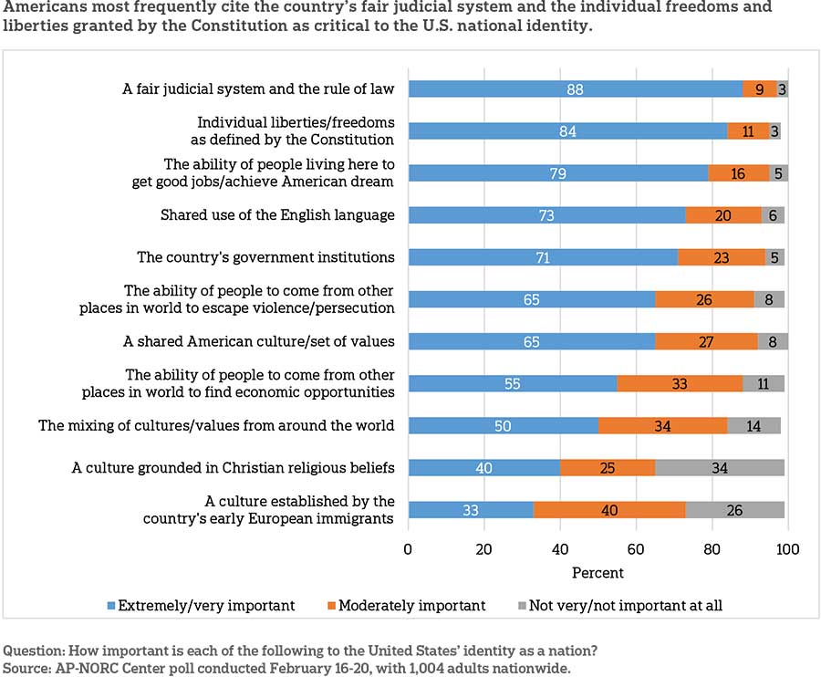

Slide 11
Markets
“Coordinates activities not through governmental planning but through the mutual interactions of buyers and sellers [in the form of transactions]”
-Charles Lindblom

Slide 12

Who cooperated to bring you your cup of coffee?

Slide 13
2.70 for a cup of coffee
0.70 cents for the coffee beans (growers, shippers, warehouses, retailers, roasters)
0.10 for the cup, lid, napkins (paper to make it, factory that does make it, shipping)
0.50 for the barista
0.20 for the store
Overhead costs in the store: utilities, managers, cleaners, advertising.
Profit

Slide 14
What role does government play in maintaining this system of market exchanges?

Slide 15
Security, property rights
Legal system to form a business
Infrastructure (roads, utilities)
Foreign relations (Coffee is probably imported)
Currency

